Slide 1







INSPIRE Webinar - 26th February 2021 INSPIRE Coverage data and service implementation candidate Good Practice Jordi Escriu, Peter Baumann, Kathi Schleidt

Slide 2
INSPIRE Coverage data and service implementation candidate Good Practice Agenda
Section 1. Introduction: Context and Summary of the candidate GP – Jordi Escriu
Section 2. Coverage basics and Standards. – Peter Baumann
Section 3. Coverages in INSPIRE. – Jordi Escriu
Section 4. Deployment of Data Sets. – Kathi Schleidt, Peter Baumann
Schema modifications + Adding INSPIRE coverage properties.
Live data ingestion demo: Data retrieval & import
Section 5. Using Coverages. – Peter Baumann
Live demos & Outlook: on WMS, Copernicus federation, Access control, Visualization.
Section 6. Conclusions & Outlook. – Jordi Escriu
Discussion & next steps. – Kathi Schleidt + ALL

Slide 3

Introduction
INSPIRE Coverage data and service implementation candidate Good Practice

Slide 4
Implementation of INSPIRE Coverages Context
Coverage – An OGC standardised way to deliver gridded (raster) data.
Identification of issues (October 2014 - today)
Inconsistencies: INSPIRE conceptual model vs. Implementation standard (CIS 1.0).
Immaturity and inconsistencies of coverage data standards (GML 3.2.1, GML 3.3, CIS 1.0).
Possible misinterpretations.
INSPIRE added additional properties and model constructs not expected in an OGC-compliant implementation (i.e. not appropriately mapped with encoding rules).
Scope
INSPIRE Thematic Clusters (October 2014 - May 2019).
INSPIRE Community Forum (From June 2019).
Team involved
Jordi Escriu (IDEC – ICGC, Catalunya - Spain).
Peter Baumann (Jacobs University + rasdaman, Germany).
Kathi Schleidt (DataCove.eu, Austria).

Slide 5
Implementation of INSPIRE Coverages Main activities run till today
“Implementation of INSPIRE Coverages” – Webinar, 6th November 2017.
“Practicing INSPIRE coverages - Enhancing your data cube implementation assets!” – Workshop, INSPIRE Conference 2018 Antwerp.
“Feel the power of INSPIRE WCS/WCPS in your hands!” – Workshop (Summary), INSPIRE Helsinki 2019.
“INSPIRE Coverages demystified” – Workshop (Description + Presentations + Video),
Online INSPIRE Conference 2020 (10th June 2020)
Presentation as candidate INSPIRE Good Practice – (Good Practice document),
63rd MIG-T Meeting (13th October 2020)
Result: Endorsed as a candidate!

Slide 6

Implementation of INSPIRE Coverages A coverage, in plain words
Variable description
(range type)
OGC CIS
Implementation model
· Tessellation (domain set)
Values
(range set)
Metadata
(MD slot)
range type
<meta>
·
·
·
2
7
3
+
+
+
·
·
·
4
1
9
·
·
·
0
2
8

Slide 7
INSPIRE Coverages Good Practice The main issue: INSPIRE Extensions
OGC CIS1.0
Implementation model
INSPIRE
Conceptual
model
INSPIRE
Implementation model
(Good Practice)
INSPIRE
range type
metadata
range type
metadata
Extensions
range type
INSPIRE Cov
Metadata
2
7
3
2
7
3
2
7
3
4
1
9
4
1
9
4
1
9
0
2
8
0
2
8
0
2
8

Slide 8
INSPIRE Coverages Good Practice An interoperable solution
Directly adopt OGC CIS 1.0 schema as default encoding (implementation model).
Replace the existing INSPIRE coverage schemas by amended INSPIRE coverage metadata schemas (*) – obtained in a very simple way (i.e. consider INSPIRE properties / extensions within the OGC coverage metadata element).
Promote the use of these interoperable schemas for their widespread use by thematic communities in the scope.
* Example schemas for EL, OI, LC available at DataCove.EU:
https://schema.datacove.eu/ElevationGridCoverageMetadata.xsd
https://schema.datacove.eu/OrthoimageryMetadata.xsd
http://test.datacove.eu/LandCoverRasterMDExt.xsd

Slide 9


INSPIRE Coverages Demystified Website and Demo service
https://inspire-wcs.eu

Slide 10
INSPIRE Coverages Good Practice Implementation and support
Available through the demonstration service: https://inspire-wcs.eu
Reusing a common endpoint: https://inspire.rasdaman.org/rasdaman/ows?
Implemented using the rasdaman.com WCS/WCPS engine.
Sample INSPIRE coverages in the scope of the EL, OI and LC themes:
Institut Cartogràfic i Geològic de Catalunya (ICGC), Spain.
Landesamt für Vermessung und Geoinformation Schleswig-Holstein (SH), Germany.
Finnish Environment Institute (SYKE), Finland.
Other data providers have additionally expressed their interest in implementing the good practice.
Looking forward for its official endorsement by INSPIRE MIG to invest resources in a comprehensive implementation.

Slide 11
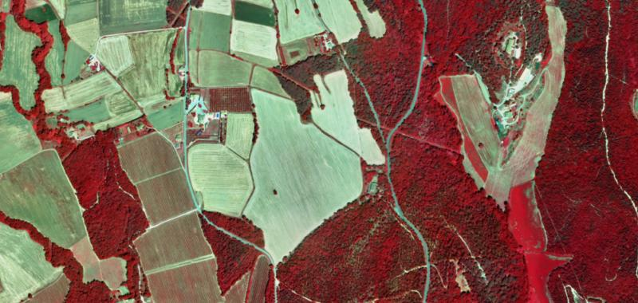
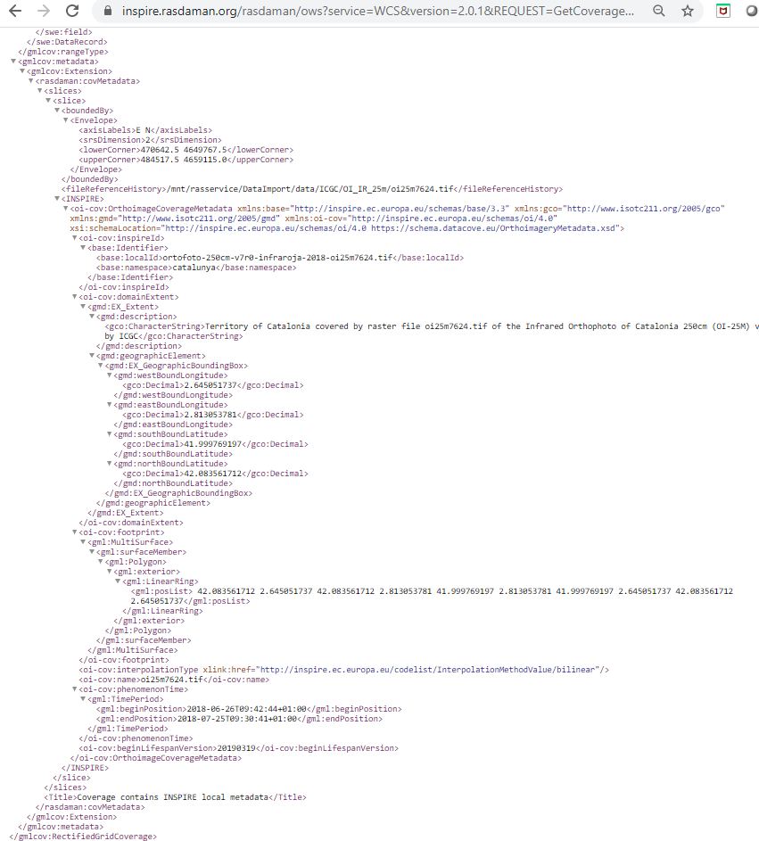
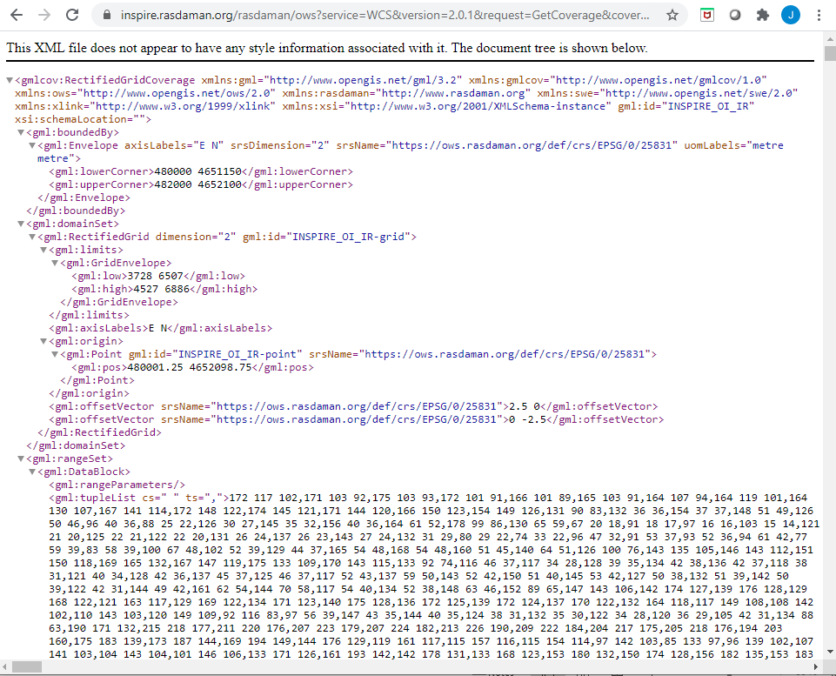
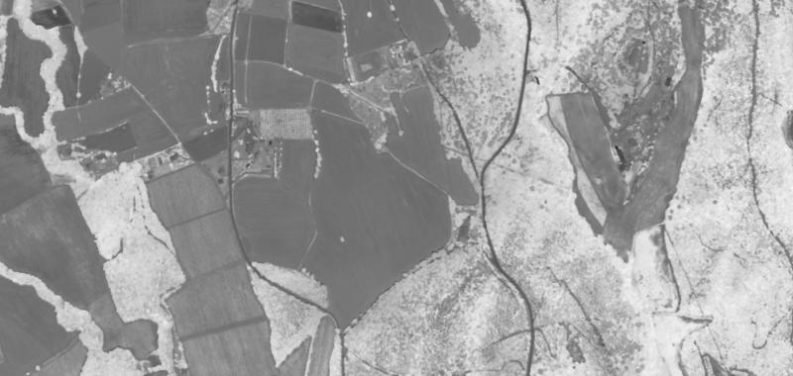
INSPIRE Coverages Good Practice Implementation and support
Sample GetCoverage requests (OI):
https://inspire.rasdaman.org/rasdaman/ows?service=WCS&version=2.0.1&request=GetCoverage&coverageId=INSPIRE_OI_IR&subset=E(480000,482000)&subset=N(4651150,4652100)&format=image/jpeg
https://inspire.rasdaman.org/rasdaman/ows?service=WCS&version=2.0.1&request=GetCoverage&coverageId=INSPIRE_OI_IR&subset=E(480000,482000)&subset=N(4651150,4652100)&format=application/gml+xml
More examples available at:
https://inspire-wcs.eu
Use of coverages in INSPIRE:

Slide 12
INSPIRE Coverages Good Practice Intended outcomes (if endorsed)
Interoperable provision of INSPIRE coverage data according OGC CIS 1.0, naturally to be offered through WCS services for at least 9 of the 13 Annex II & III themes involved.
Amended INSPIRE coverage application schemas.
Facilitation of coverage data and services implementation tasks, providing the INSPIRE community with a common, clear implementation path to be reused by many.
Underpinning of WCPS data analytics based on the availability of INSPIRE coverage data (i.e. data cubes), cornerstone for boosting big data technologies across EU.
Optionally, update of the INSPIRE Framework documents.

Slide 13
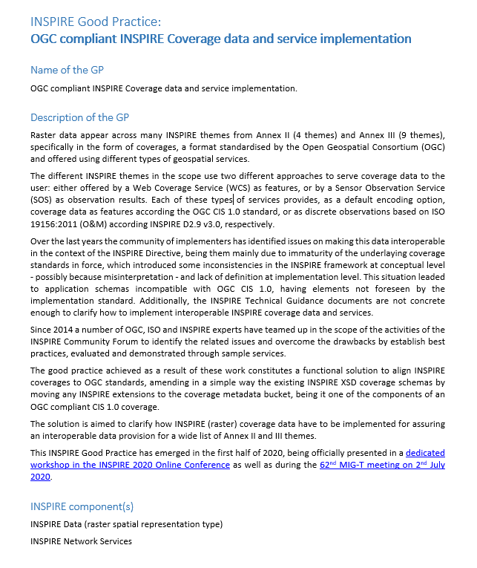

INSPIRE Coverages Good Practice Main Links & References
This Good Practice document:
https://webgate.ec.europa.eu/fpfis/wikis/download/attachments/559350289/INSPIRE_Coverages_good_practice_v3.pdf?version=1&modificationDate=1612537038530&api=v2
Amended schemas (EL, OI, LC):
https://schema.datacove.eu/ElevationGridCoverageMetadata.xsd
https://schema.datacove.eu/OrthoimageryMetadata.xsd
http://test.datacove.eu/LandCoverRasterMDExt.xsd
Website & Demo service:
https://inspire-wcs.eu

Slide 14

INSPIRE Coverages Good Practice Additional Links & References
Results & Demos from the “INSPIRE Coverages demystified” session (Online INSPIRE Conference 2020), focused on OI, EL, LC:
https://inspire.ec.europa.eu/conference2020/webinars/inspire-coverages-demystified
INSPIRE coverage (metadata) schemas.
Examples of WCS/WCPS services.
Examples of INSPIRE coverage metadata.
“INSPIRE coverages: an analysis and some suggestions” - Article with first suggestions:
https://link.springer.com/article/10.1186%2Fs40965-019-0059-x

Slide 15
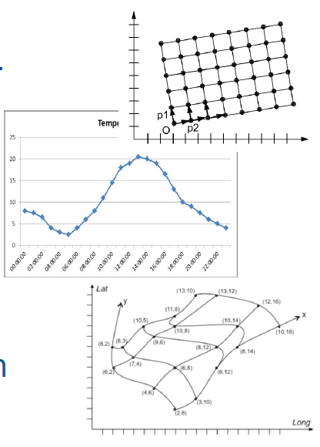
Coverage basics and Standards

